Slide 1
Recommendation systems

Slide 2
Agenda
Why recommendation systems?
Real world examples and historical trends
Basic techniques of recommendation
Popularity based
Classification
Content based
Collaborative filtering
Hybrid approaches
Evaluation of recommendation
Python examples
Advances in recommendation systems

Slide 3

We are overloaded
Thousands of news articles and news blogs each day
Millions of movies, books, music tracks online
Several thousands of ad messages sent to us each day
But is it new topic?
what is new?

Slide 4
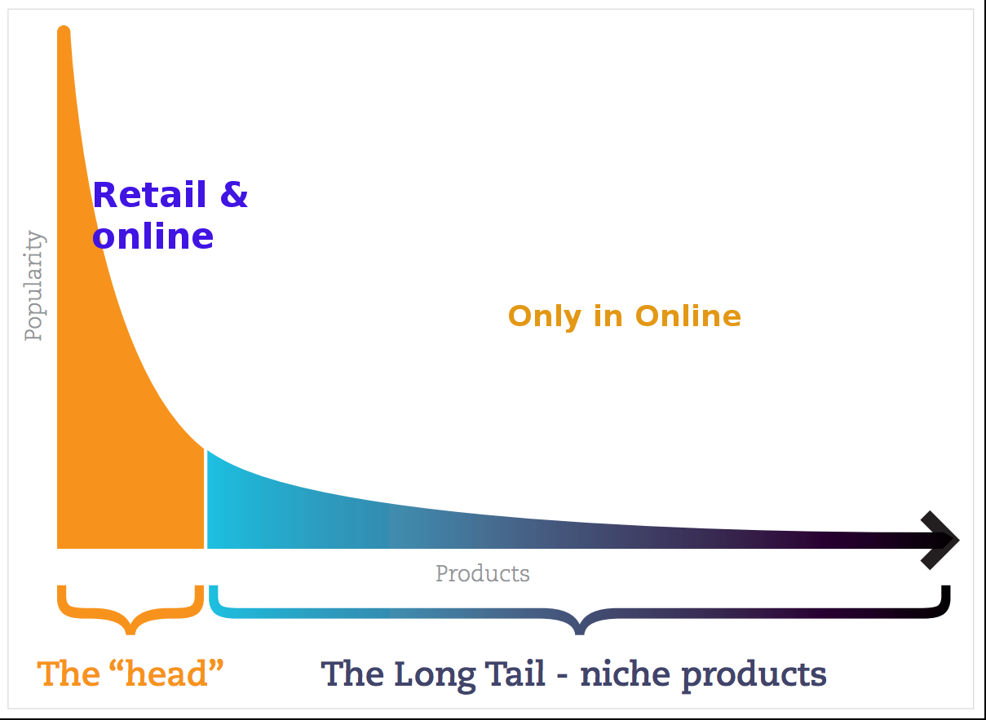
From scarcity to abundance
Limited resources:
Shelf space
No of hours for TV shows
No of theaters for Movies
Web enabled near-zero-cost dissimination of information about products
Reliance vs Amazon
long tail phenomenon
Cut off point
Area of the curve
Source: http://dataaspirant.com/2015/05/25/collaborative-filtering-recommendation-engine-implementation-in-python/

Slide 5
Why Recommendation System?
What we can solve?
Help user find item of their interest.
Help item provider deliver their items to right user.
Identify products most relevant to the user
Personalized content
Eg. Top n offers
Help website improve user engagement.
Recommender system creates a matching between users and items and exploits the similarity between users/items to make recommendations.

Slide 6
What can be recommended?
Advertising messages
Movies
Books
Music tracks
News articles
Restaurants
Future friends (Social network sites)
Courses in e-learning
Jobs
Research papers
Investment choices
TV programs
Citations
Cloths
Online mates (Dating services)
Supermarket goods

Slide 7
User and matching items
Amazon Users: members, Items: products, books etc.
Netflix Users: members, Items: movies, TV shows
LinkedIn Users: members, Items: members
Facebook Users: members, Items: jobs
Power of Recommendations*:
Netflix: – 2/3 rented movies are from recommendation
Google News – 38% more click-through are due to recommendation
Amazon – 35% sales are from recommendation
*(Celma & Lamere, ISMIR 2007)

Slide 8


Recommendation historical trends
In 1988, Mr. Joe Simpson, an English mountain climber, wrote a book called Touching the Void. It got good reviews but was considered as modest success and it was soon forgotten.
However, a decade later, an interesting thing happened. Mr. Jon Krakauer wrote a book called Into Thin Air, a thriller about a mountain-climbing tragedy, which became a publishing sensation. Suddenly, Touching the Void started to sell again.
Published in 1988
Published in 1996

Slide 9
Real world examples
•GroupLens(https://grouplens.org/)
Helped in development of initial recommender systems by pioneering initial collaborative filtering models
Provided various datasets –MovieLensand BookLens
•Amazon –Did lot of work on implementing commercial recommender systems
They also implemented lot of computational improvements
•Netflix Prize
Pioneered Latent Factor/Matrix Factorization models
•Google –You Tube
Hybrid recommendation systems
Deep Learning Based Systems
•Social Network Recommendations

Slide 10

Perfect matching item may not exist
Product #1
HD: 500 GB
Memory: 8 GB
Processor: i7
Price: $550
I want a laptop with 500GB HD, 8GB memory and i5 processor for $400
Product #3
HD: 250 GB
Memory: 6 GB
Processor: i5
Price: $450
Product #2
HD: 250 GB
Memory: 4 GB
Processor: i3
Price: $350

Slide 11
Types of recommendation systems
Popularity based recommendations
Classification model based
Content based recommendations
Nearest neighbour collaborative filtering:
User based
Item based
Hybrid approaches
Association rule mining

Slide 12
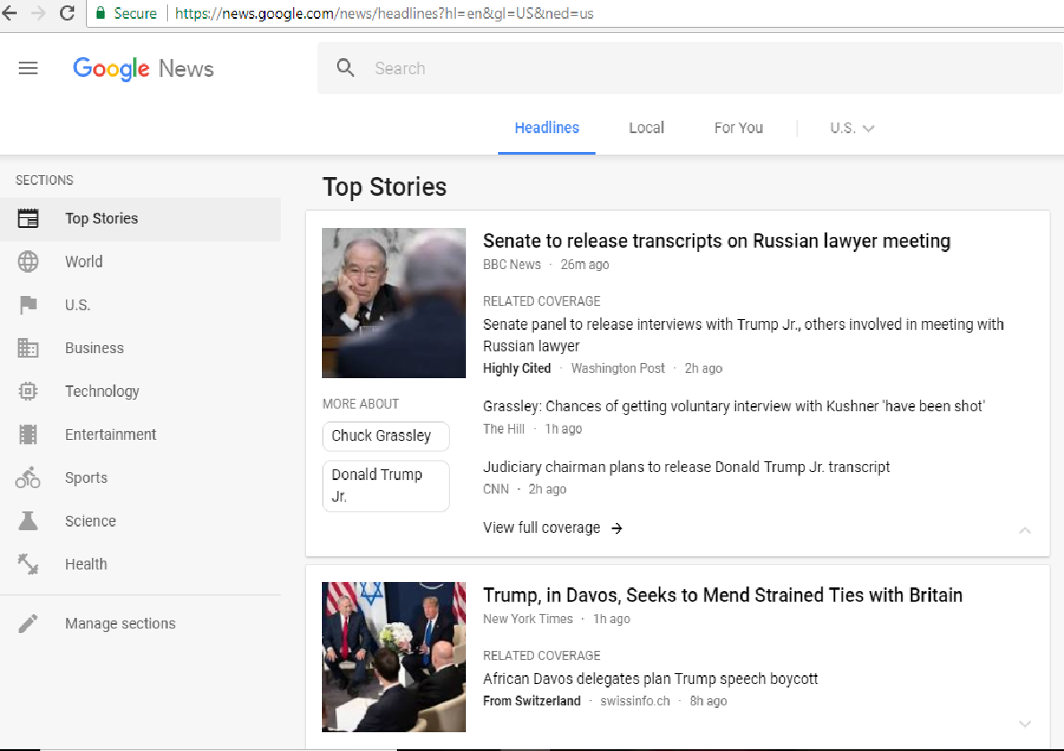
Popularity based Recommender System
Popularity based recommendation system works by recommending items viewed/purchased by most people and rated high
Recommendations: Ranked list of items by their purchase count / viewed count
“Popular News”
It uses:
Can use context
Purchase history
User and item features
Scalale
Not a personalized recommendation

Slide 13
Classification model
Uses features of both products as well as users in order to predict whether a user will like a product or not.
Limitations.
It is not easy to collect quality information about products and users.
Even if we are able to collect good information, they may not be sufficient to make a good classifier
Scalability issue
User Features
(Eg. Age, Gender)
Product Features (Eg. cost, quality)
Purchase History
Classifier
Like/Not like
The outcome can be 1 if the user likes it else 0
Incorporates personalization

Slide 14
Content based recommendations
Recommendations are based on information on the content of items rather than on other users’ opinions.
Main idea:
If a user likes an item then he/she will also like a “similar” item
Recommend items based on their similarity:
Recommend items to customer x similar to previous items rated highly by x
Uses a machine learning algorithm to induce a profile of the users preferences from examples based on a featural description of content.
No need for data on other users.
No cold-start or sparsity problems.
Able to recommend to users with unique tastes.
Techniques that can be used: Cosine similarity

Slide 15
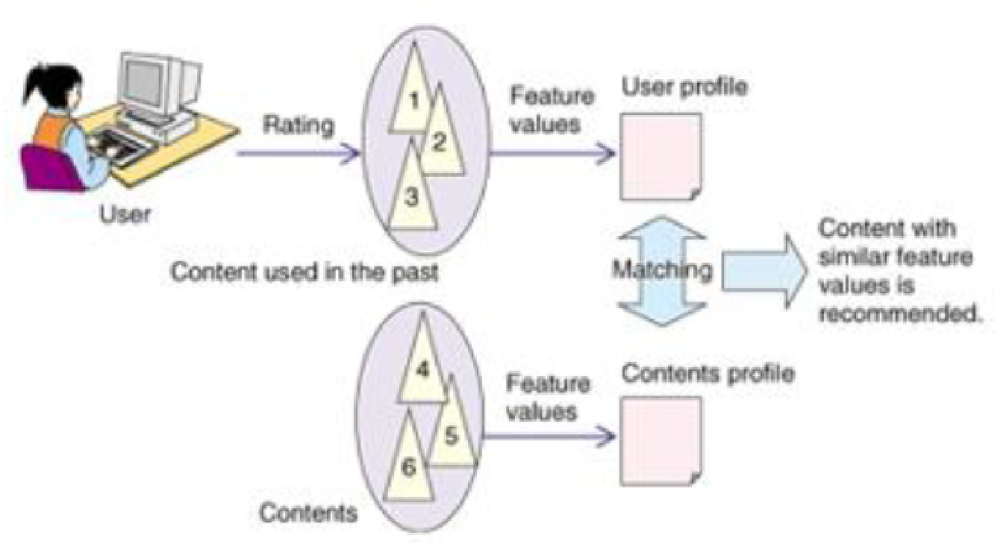
Content based recommendation system
Item Profiles:
set of features
vector
User profiles:
Weighted average of rated item profiles
Normalize rating using average rating of user
Source: cs.uky.edu

Slide 16
Content based recommendation system
Advantages
Content-based recommender systems don’t require a lot of user data.
We just need item data and you’re able to start giving recommendations to users.
Recommendation engine does not depend on lots of user data, so it is possible to give recommendations to even your first customer as long as you have adequate data to build his user profile. Does not suffer from cold start
Less expensive to build and maintain
Challenges
Your item data needs to be well distributed
Availability of features which explain Items and user preferences
Recommendations will likely be direct substitutes, and not complements, of the item the user interacted with. This is one of the key reasons why collaborative filtering provides better recommendations
Less dynamic

Slide 17
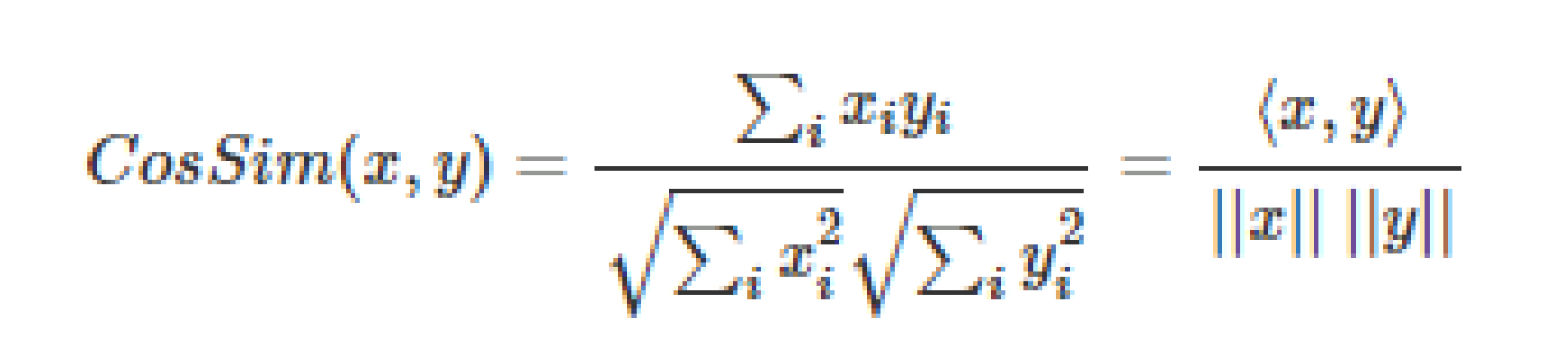
Cosine Similarity:
Cosine Similarity is the cosine of the angle between the 2 vectors A and B
Closer the vectors, smaller will be the angle and hence larger their cosine value.

